Slide 1



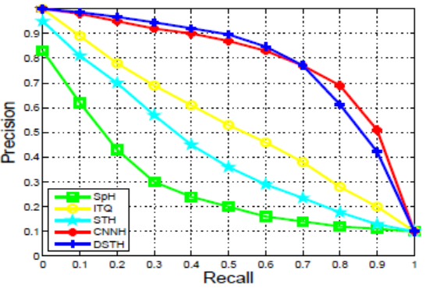
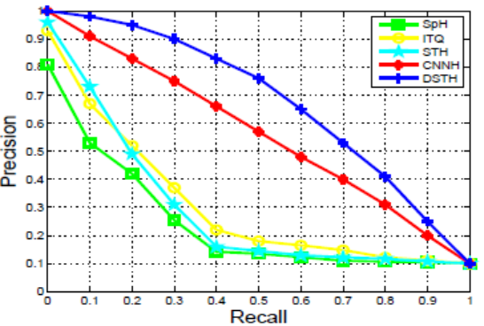
Deep Self-taught Hashing for Image Retrieval
01111
Ke Zhou, Yu Liu, Jinkuan Song, Lingyu Yan, Fuhao Zou, Fumin Shen.
Huazhong University of Science and Technology. {k.zhou,liu_yu,yanranyaya,fuhao_zou}@hust.edu.cn
01011
University of Trento. Jingkuan.song@unitn.it
University of Electronic Science and Technology of China. fumin.shen@gmail.com
10000
Abstract
Approach
Framework
In view of the superiority of deep structure, especially the Convolutional Neural Networks (CNNs), on extracting high level representation, we propose a deep self-taught hashing (DSTH) framework to combine deep structures with hashing to improve the retrieval performance by automatically learning robust visual features and hash functions. By employing CNNs, more robust and discriminative features of the images can be extracted to benefit the hash codes generation. Then, we apply CNNs and Multi-layer Perceptron under deep learning scheme to learn hash function in supervised process by using the generated hash codes as labels. The experimental results have shown that the DSTH is superior to several state-of-the-art algorithms.
We propose an unsupervised and supervised learning algorithm under deep learning scheme which is composed of unsupervised and supervised learning stages.
1. Unsupervised learning stage
we mainly focus on generating hash labels. First, to capture discriminative fine features, we introduce CNNs to promote fine grained feature extraction with class labels. Second, we apply LE for dimension reducing and binaryzation for generating hash labels.
2. Supervised learning stage
we mainly focus on using the hash labels acquired in the unsupervised learning stage to get hashing model. First, using hash labels acquired in unsupervised learning stage, we employ CNNs again to receive fine grained features. Then, we take advantage of single-hidden-layer MLP, which is an artificial neural network (ANN) and consists of input layer, hidden layer and output layer. It can adjust input to approximate output according to change weights on different nodes in hidden layer.
MNIST Digits
MNIST is a handwriting image set which contains 60000 training images and 10000 test images, each of size 28×28 pixels, with a label from 0 to 9
STL-10 dataset
STL-10 is a sub-set of ImageNet dataset for image recognition, which consist of 5000 training images (500 images per class), 8000 test images (800 images per class) and 100000 unlabeled images, each of size 96×96 pixels, in 10 classes.
We propose Deep Self-taught Hashing(DSTH) learning algorithm for image retrieval. The main contributions to propose a self-taught hash learning algorithm on deep learning framework and introduce hash labels derived from image feature into hashing model learning. First, using CNNs in unsupervised learning stage to generate hash labels, we make it successful to maximize the value of image itself, leading to much more accurate image representation than hand-crafted extracted feature used in shallow model. Second, in terms of both feature extraction and hash label generation, we utilize deep architecture simultaneously to promote the hash models, leading to excellent performance on big size images dataset.
Experiment
Conclusion
64-bit codes retrieving accuracy of our approach DSTH compared to other algorithms with CLS = {C(6; 5); S(2);C(12; 5); S(2)}.
We design more complex level of layers for 48-bit codes. CLS = {C(5; 5); S(2);C(10; 3); S(2);C(20; 3); S(2);C(30; 3); S(2)}:

